Slide 1
Attracting and Enjoying Backyard Birds

Slide 2
What do Birds Need? “Birds abhor a clean yard..”
Space
What type of yard (wooded, field…)
Habitat structure
Food
Feeders, fruiting and flowering plants. Diversity (magnolia, black gum, smilax, Virginia creeper, trumpet creeper)
Water
Baths, pools, streams, misters
Shelter
Vegetation at multiple levels
Bird Boxes
Brush Piles
Standing snags

Slide 3
Georgia Yard Birds
Residents (year round)
Cardinal, Chickadee, Titmouse, Woodpeckers
Short Distance Migrants (winter in southeast)
White-throated Sparrow, Ruby-crowned Kinglet
Long Distance Migrants (leave the US.)
Thrushes, Warblers, Tanagers

Slide 4
Resident Birds Using permanently available food sources
Granivores - eat seeds
Often will visit feeders
Various types of feeders
Frugivores - eat fruit and berries
Visit fruiting shrubs, berries
Carnivores – eat other animals
Hawks and Owls
Visit your feeders to catch birds

Slide 5
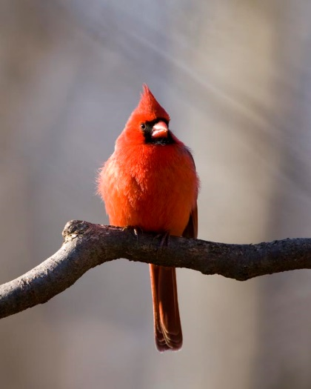
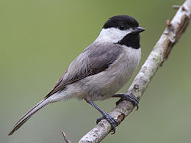
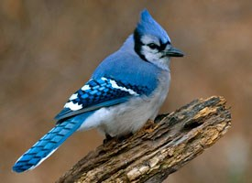
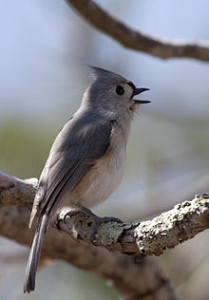
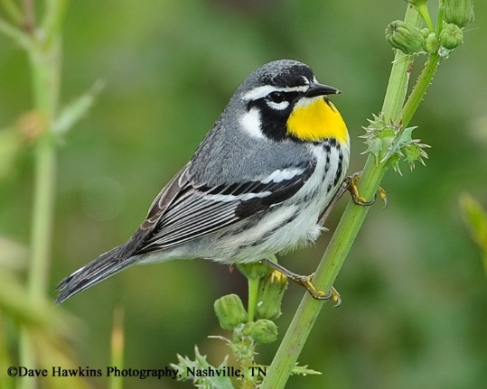
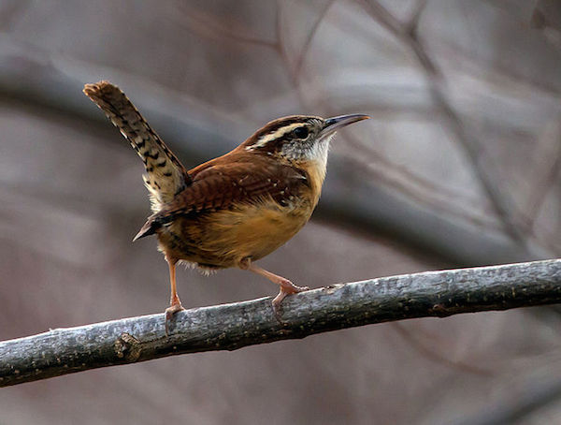
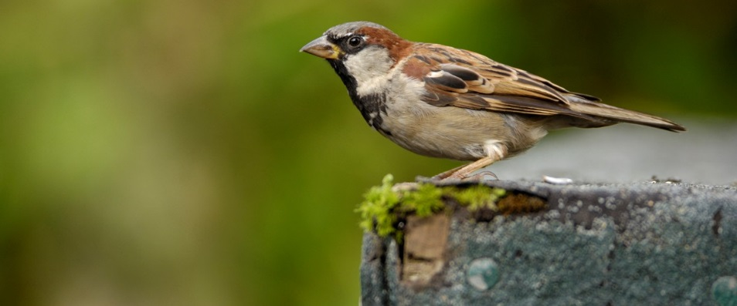
Common Resident Birds
Carolina Chickadee
Blue Jay
Northern Cardinal
Tufted Titmouse
Yellow-throated Warbler
House Sparrow
Carolina Wren

Slide 6
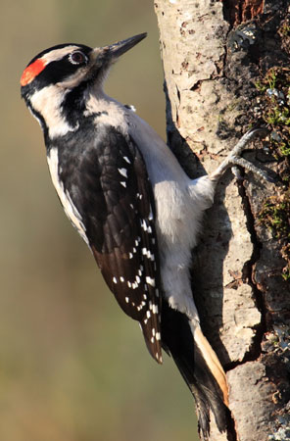
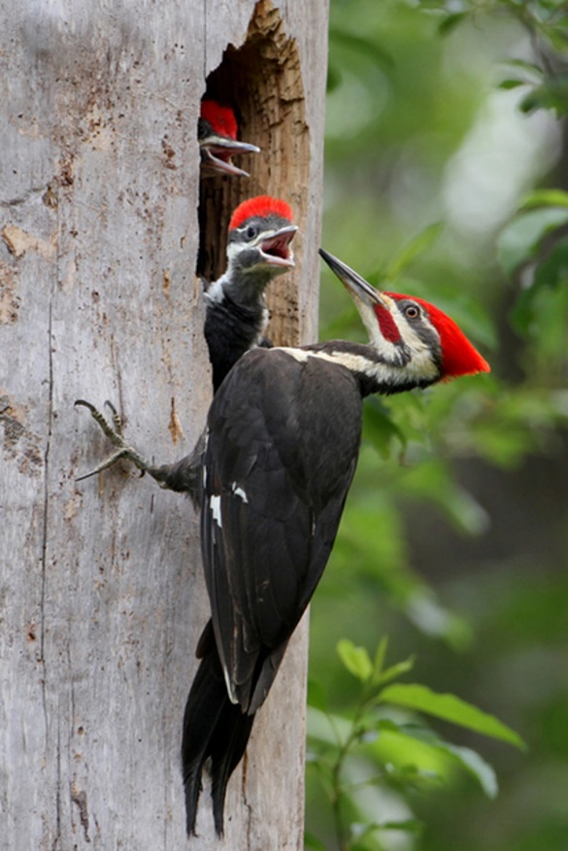
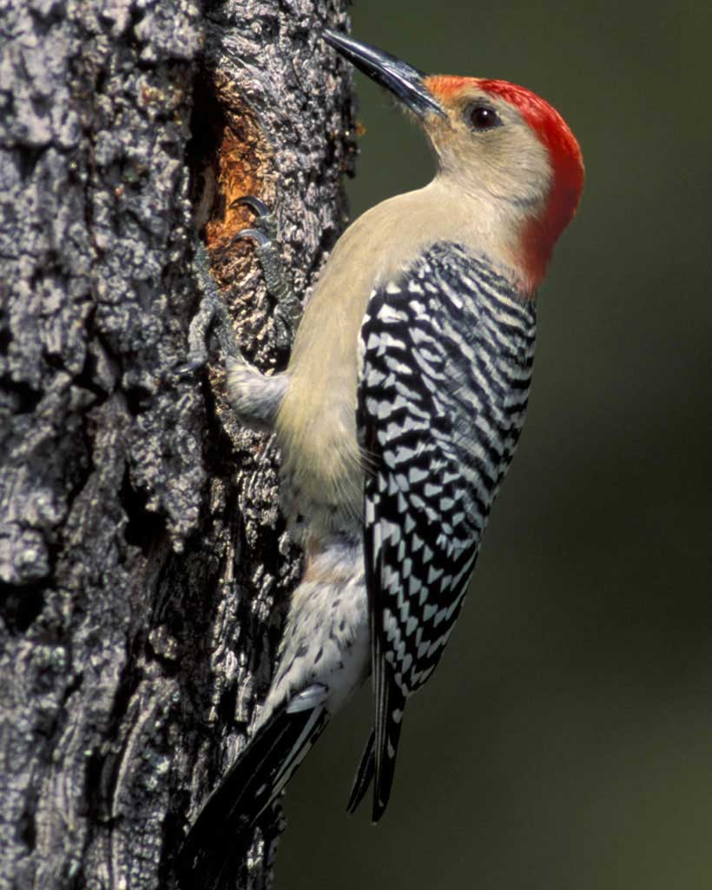
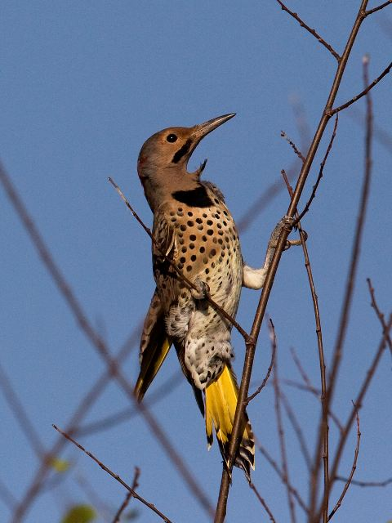
Resident Woodpeckers
Hairy Woodpecker
Pileated Woodpecker
Northern Flicker
Red-bellied Woodpecker

Slide 7
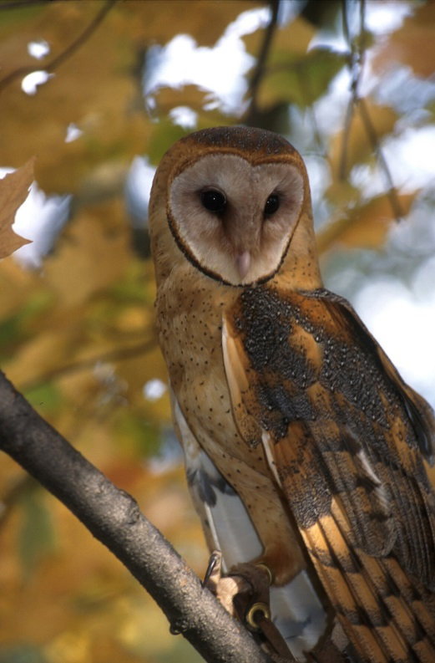
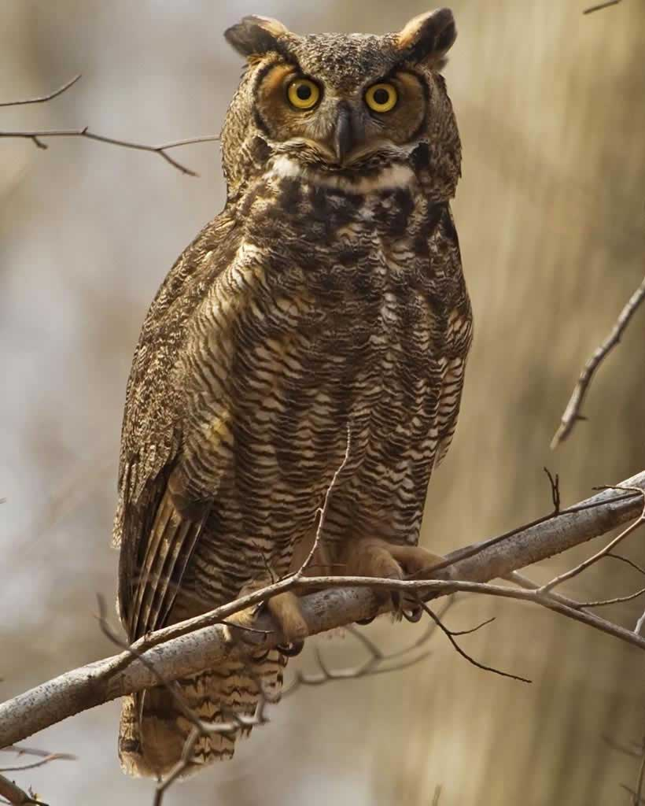
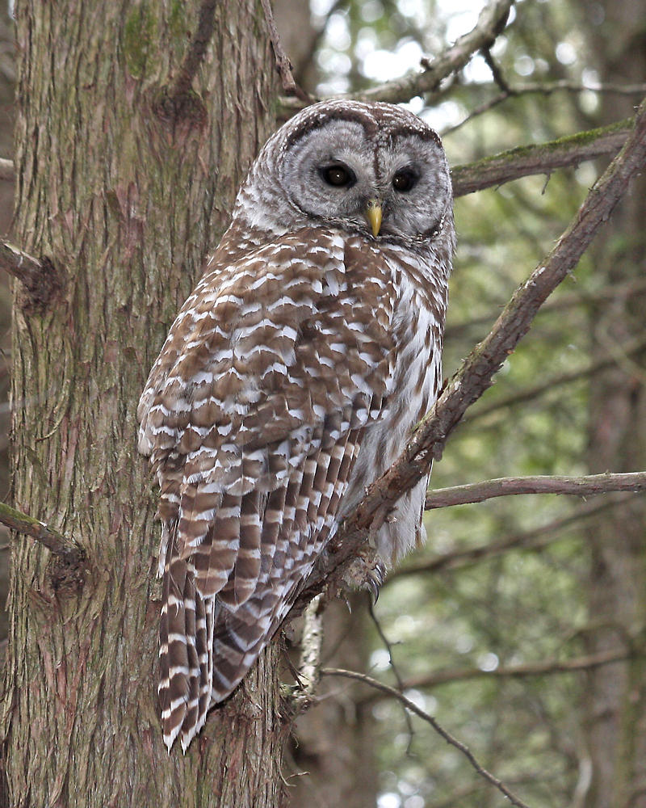
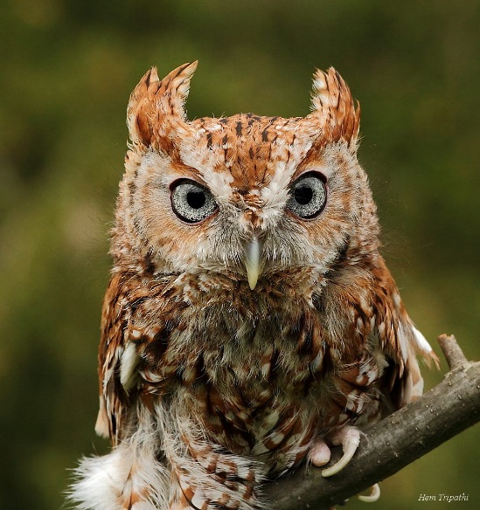
Owls of Georgia All possible Yard Birds
Barn Owl
Great Horned Owl
Barred Owl
Eastern Screech Owl

Slide 8
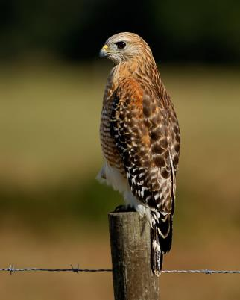
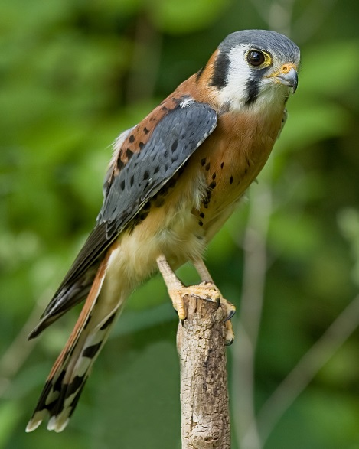
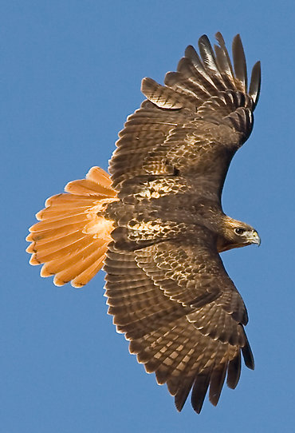
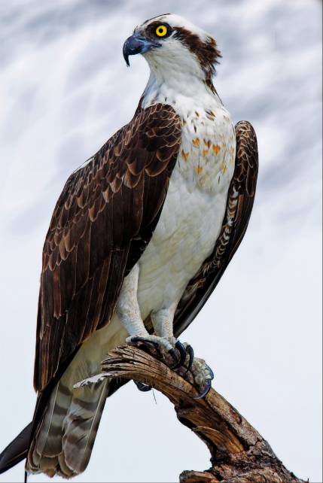
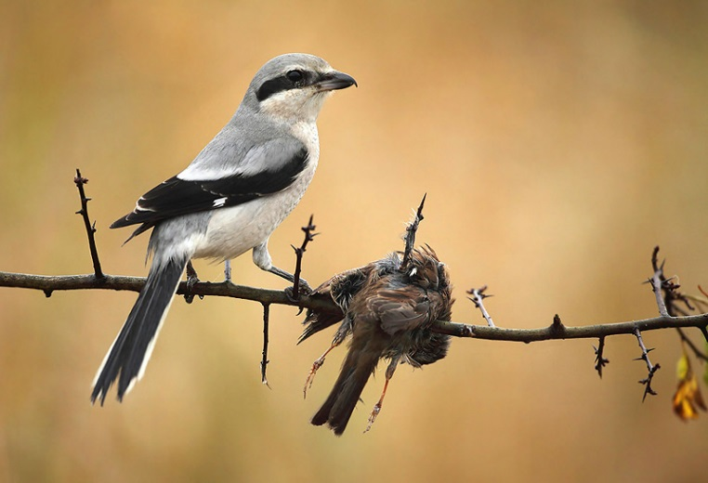
Raptors of Georgia
Red Shouldered Hawk
American Kestrel
Cooper’s Hawk
Osprey
Red Tailed Hawk
Loggerhead shrike

Slide 9
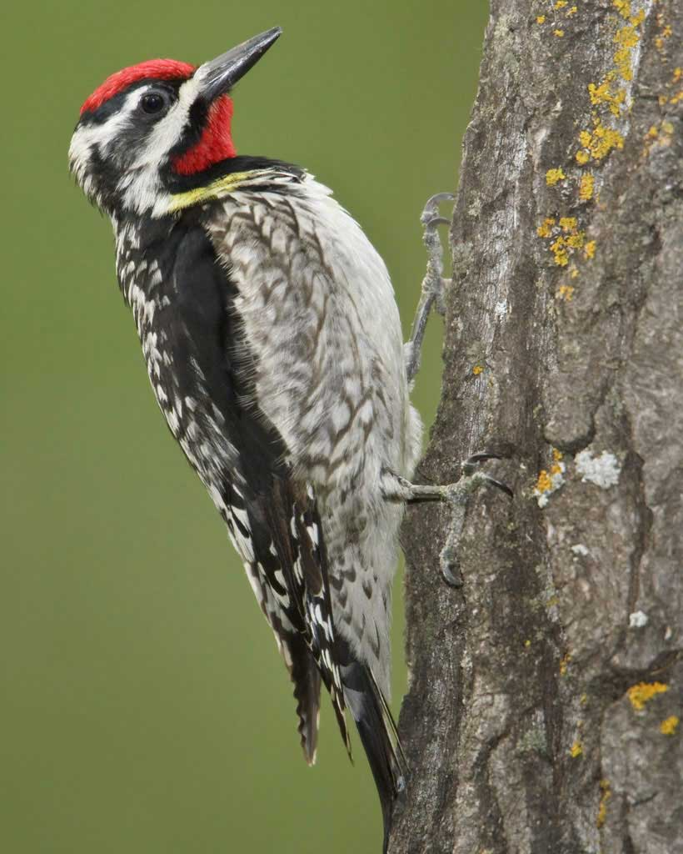
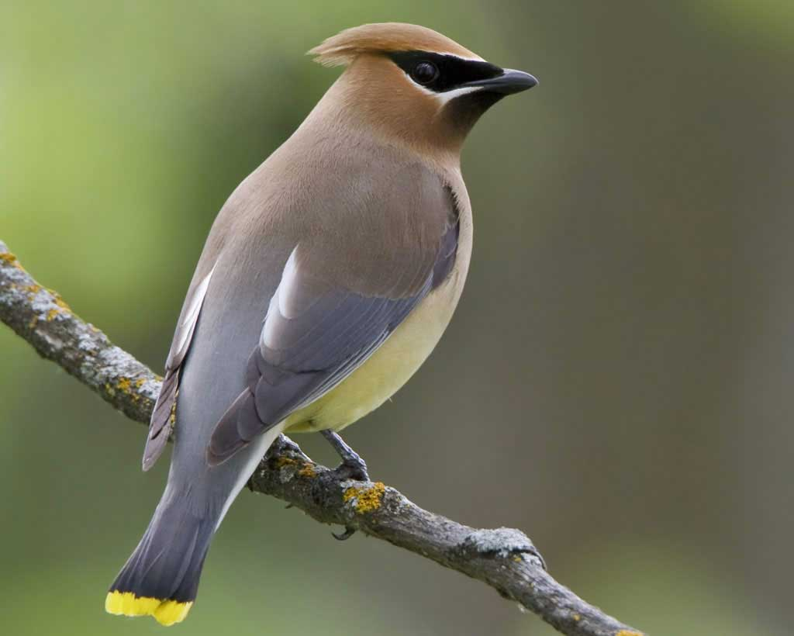
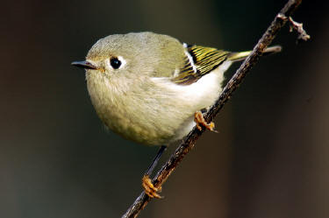
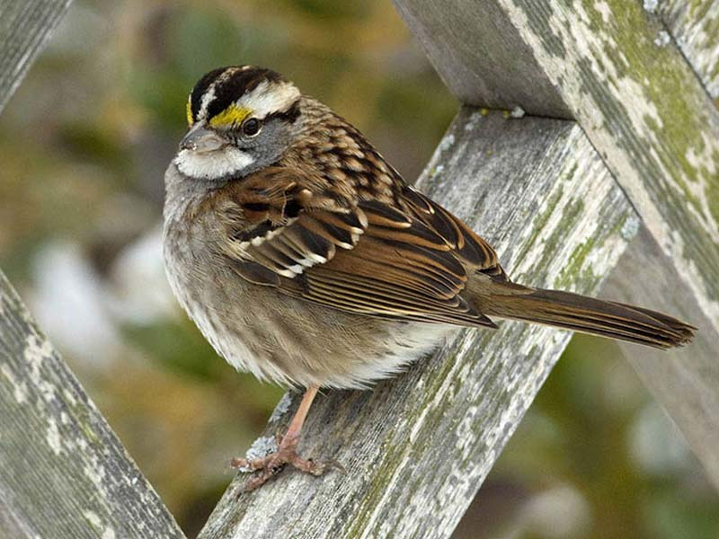
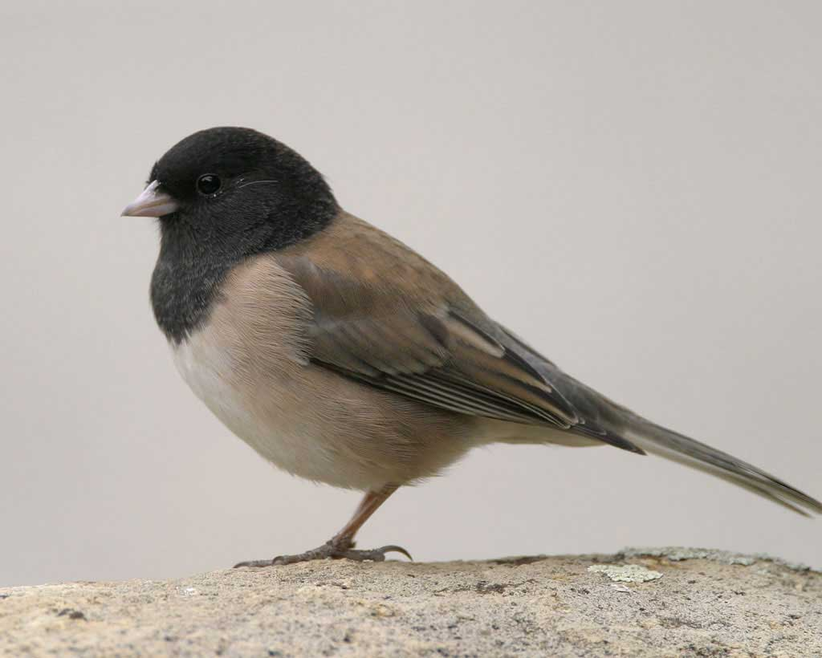
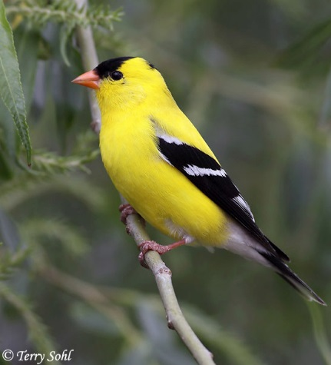
Short Distance Migrants Winter in your yard
Ruby-crowned kinglet
Yellow-bellied Sapsucker
Cedar Waxwing
Dark-eyed Junco
Goldfinch
White throated Sparrow

Slide 10
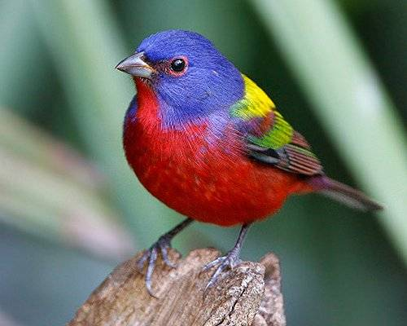
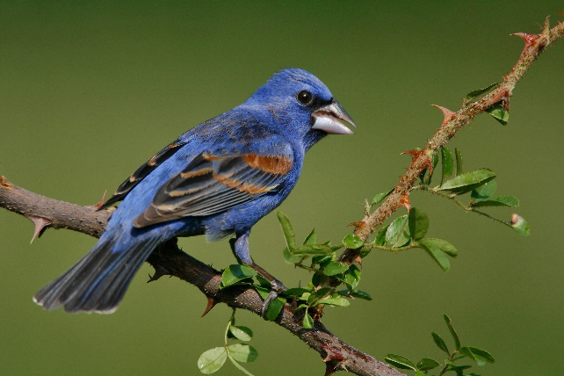
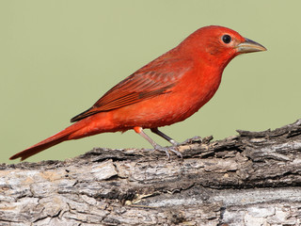
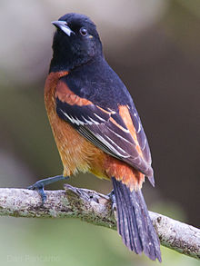
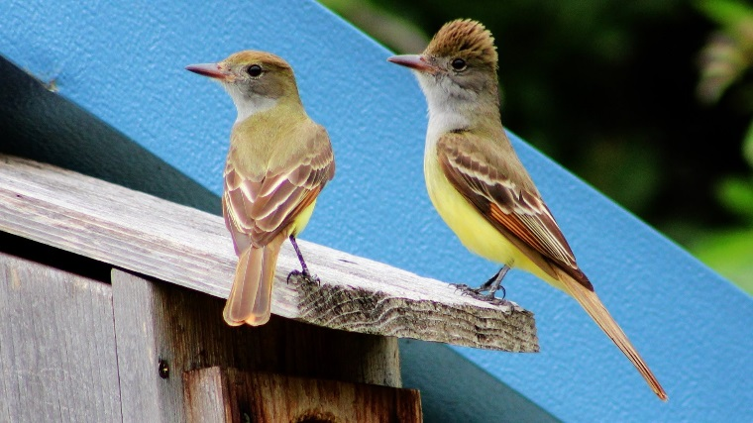
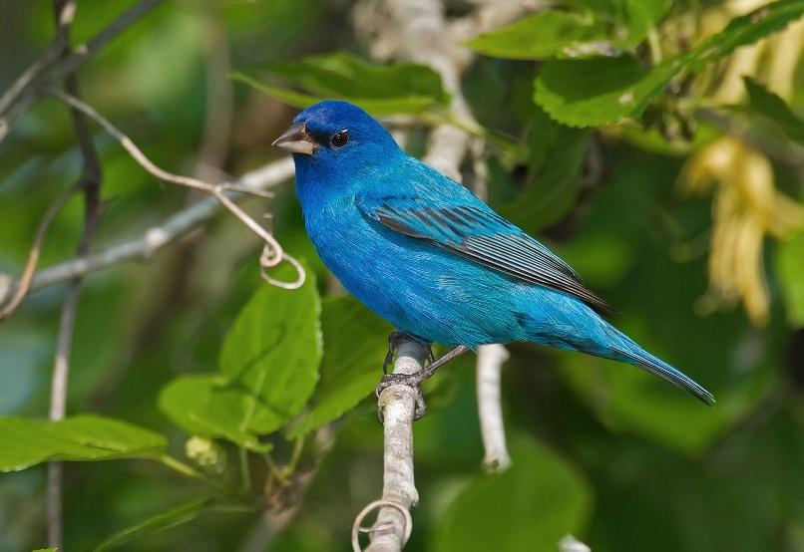
Long Distance Migrants Summer in your yard
Blue Grosbeak
Painted Bunting
Summer Tanager
Great-crested flycatcher
Indigo Bunting
Orchard Oriole

Slide 11
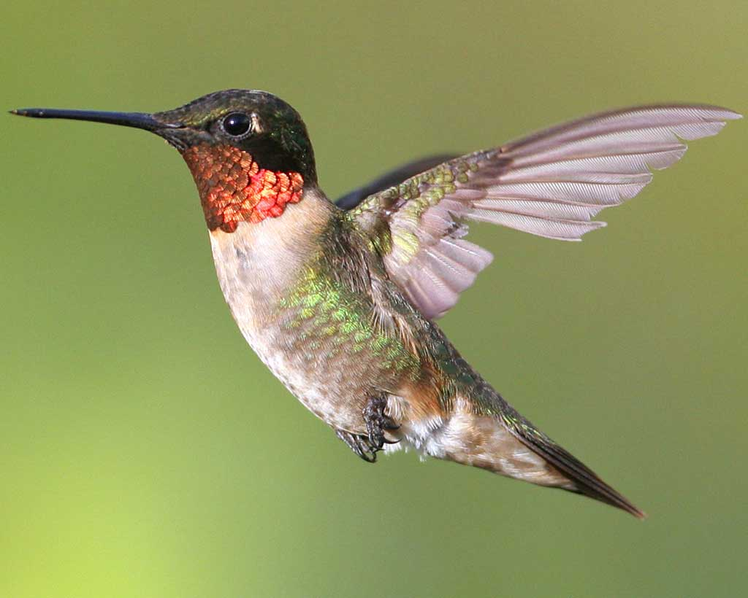
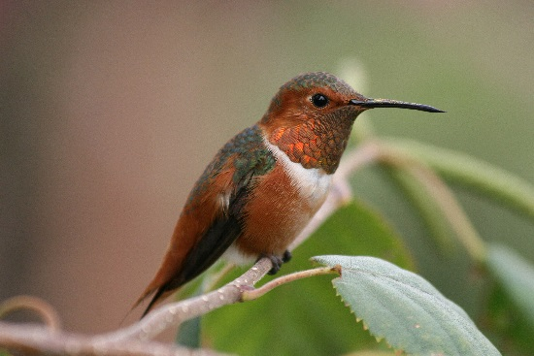
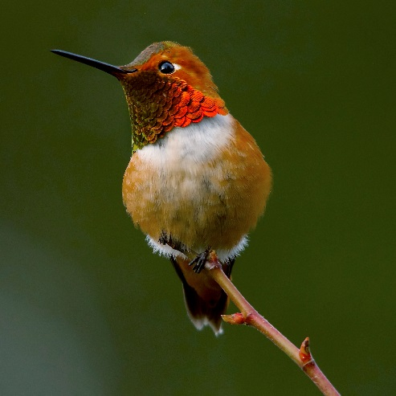
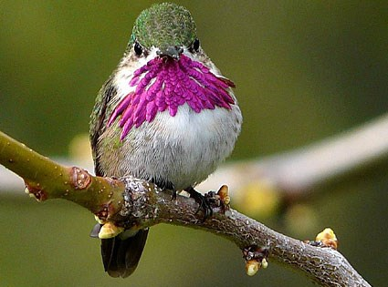
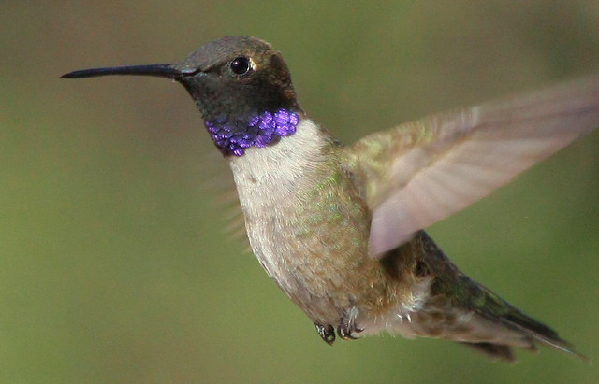
Hummingbirds
Calliope
Allen’s
Ruby-throated
Rufous
Black-chinned
Try to keep flowering plants all year
Summer – Ruby-throated Hummingbird
Winter – variety of western species
Rufous, Allen’s, Calliope, Black-chinned

Slide 12
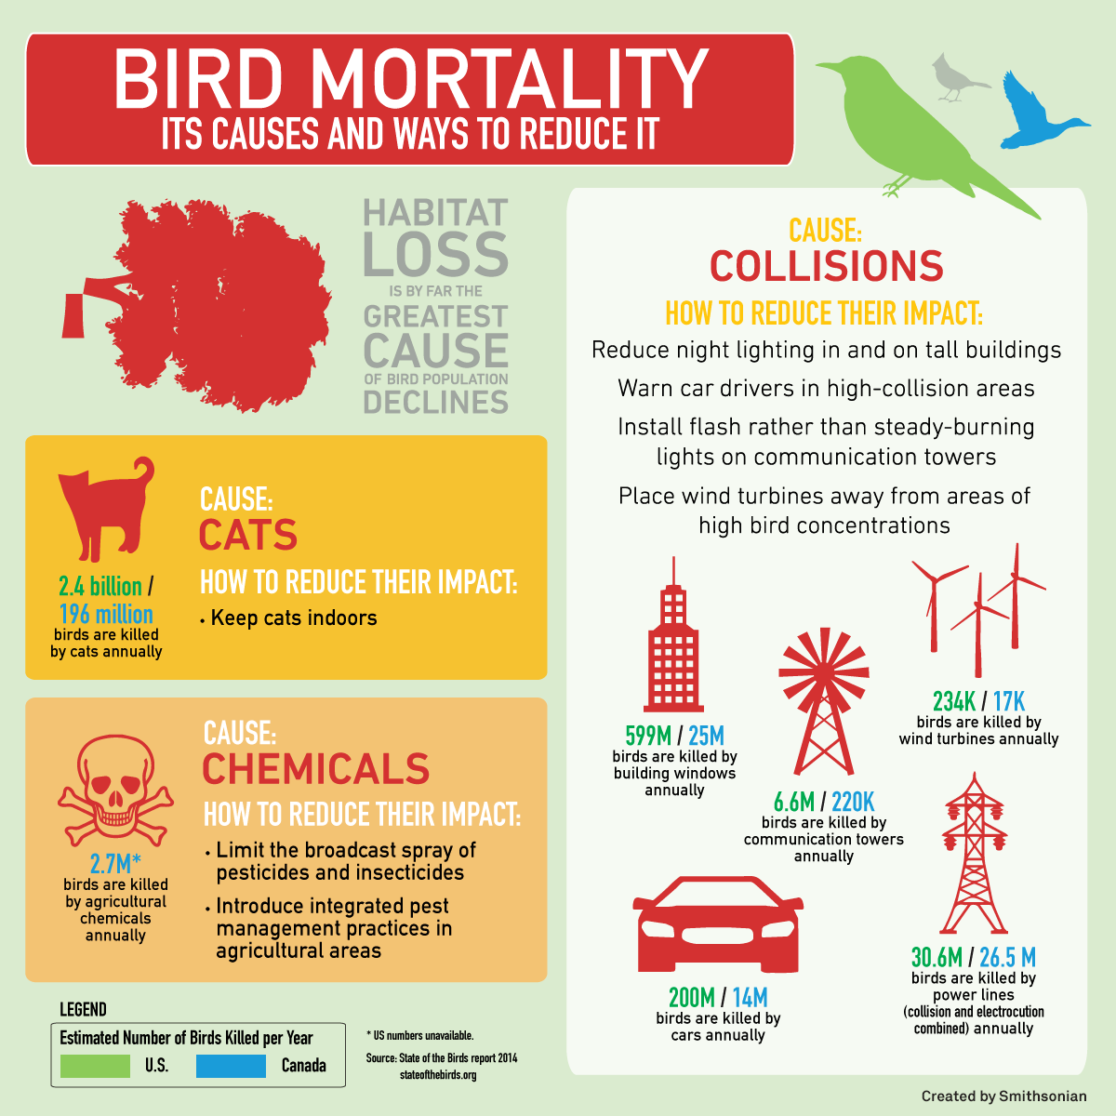
Threats to Yard Birds
Cats
Keep cats indoors
Keep feeders and water sources open enough that cats can’t sneak up on birds
Large window panes
Stickers on window
Put feeders close to window
Diseases/rancid food
clean and change feeders and food regularly
Herbicides/Pesticides
Try a chemical free yard

Slide 13
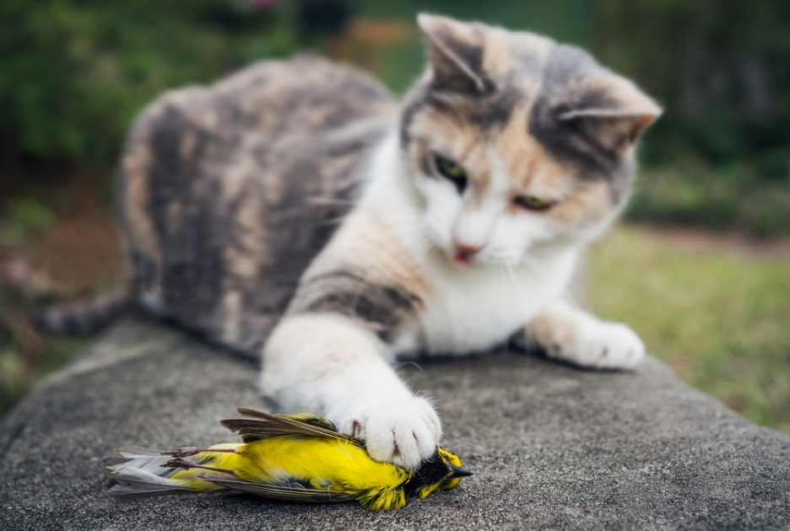
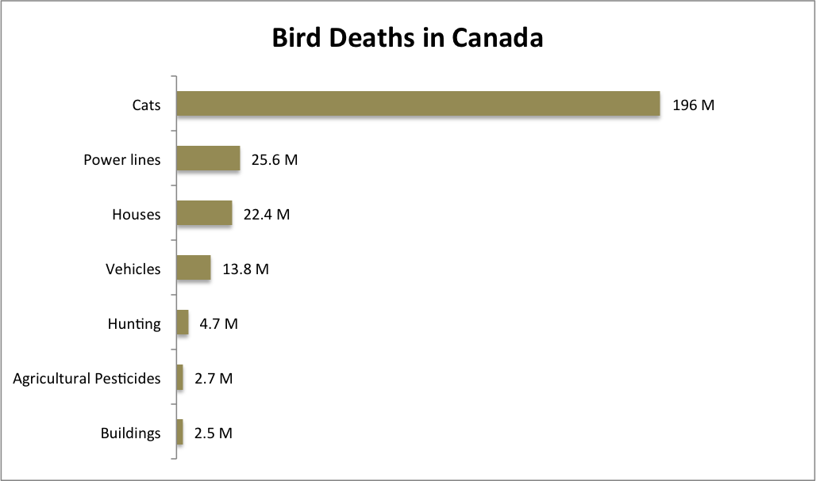
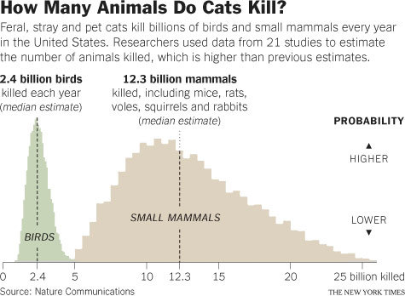
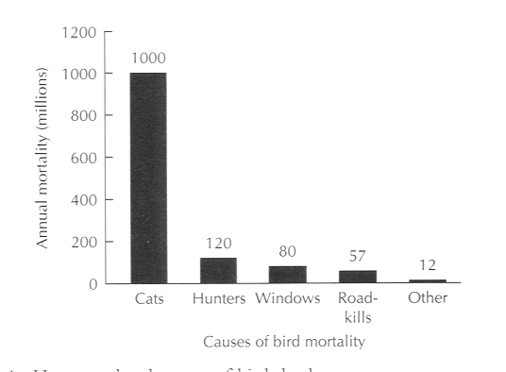
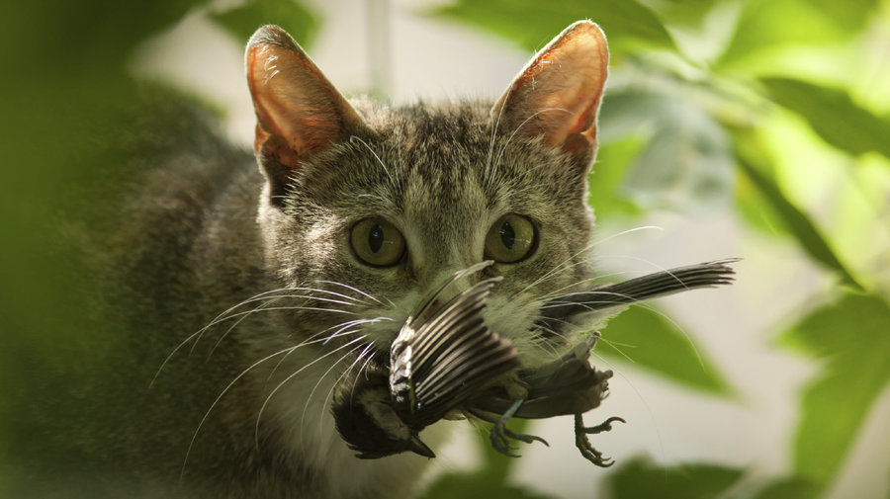
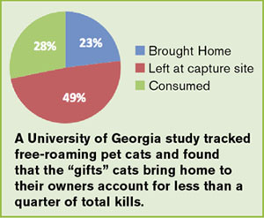
Cats
73 million pet cats in US
60-100 feral and stray cats
Kill 1 billion birds annually
8 species of island birds driven to extinction by cats

Slide 14
Planting Natives for Birds
Trees
Black gum (Nyssa sylvatica)
Tulip poplar (Liriodendron tulipifera)
Water Oak (Quercus nigra)
American Beech (Fagus grandiflora
Flowering Dogwood (Cornus Florida
Wild Cherry (Prunus serotina)
Eastern Red Cedar (Juniperus virginiana)
Sweetgum (Liqidambar styraciflua)
Southern Magnolia (Magnolia grandiflora)

Slide 15
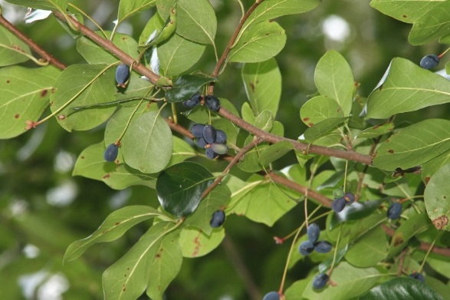
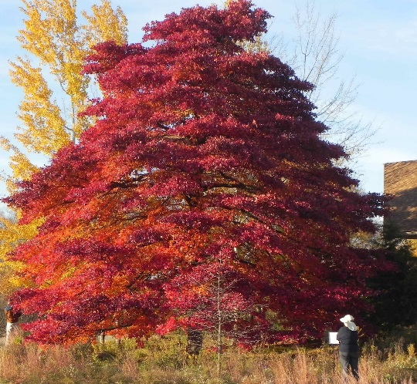
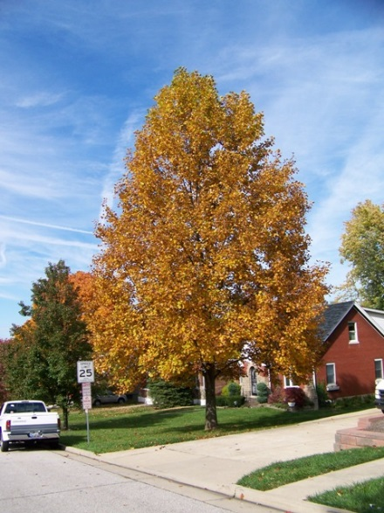
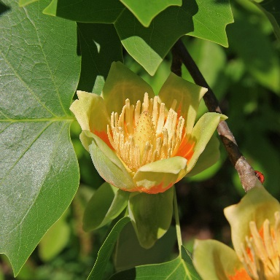
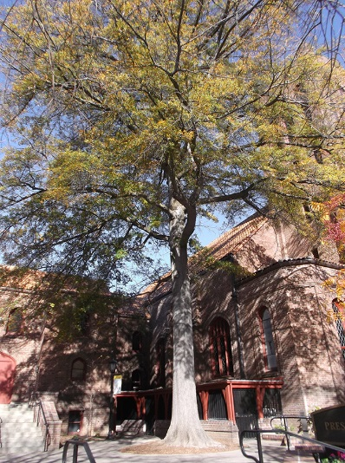
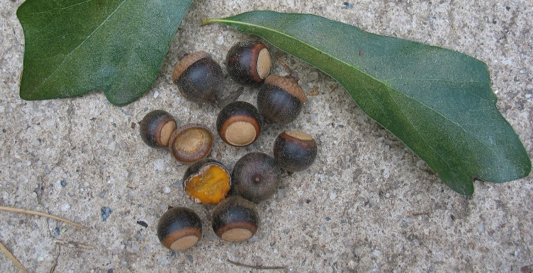
Trees
Black gum (Nyssa sylvatica)
American Robin, Summer Tanager, Brown Thrasher, Gray Catbird, Wood Thrush
Tulip poplar (Liriodendron tulipifera)
Cape May Warbler, Rose-breasted Grosbeak, American Goldfinch, Northern Cardinal, Carolina Chickadee, Tufted Titmouse, Yellow-rumped Warbler, Pine Warbler,
Native Oaks (Quercus nigra, laurifolia, hemisphaerica, virginiana)
Redheaded Woodpecker, Brown-headed Nuthatch, Tufted Titmouse, Cape May Warbler, Worm-eating Warbler, Yellow-rumped warbler.

Slide 16
Trees
American Beech (Fagus grandifolia
Rose-breasted Grosbeak, Tufted Titmouse, Carolina Chickadee, Northern Cardinal, Worm-eating Warbler
Flowering Dogwood (Cornus florida)
Summer Tanager, American Robin, Gray Catbird, Northern Cardinal, Eastern Towhee, Brown Thrasher, Wood Thrush
Wild Cherry (Prunus serotina)
Northern Mockingbird, Brown Thrasher, Gray Catbird, American Robin, 33 species at least

Slide 17
Trees
Southern Red Cedar (Juniperus virginiana)
Cedar Waxwing, Tufted titmouse, Carolina Chickadee, Carolina Wren, Yellow-rumped Warbler, Brown-headed Nuthatch, American Robin
Sweetgum (Liqidambar styraciflua)
American Goldfinch, Cape May Warbler, Worm-eating Warbler, Carolina Chickadee, Tufted titmouse, Brown-headed Nuthatch, Carolina Wren
Southern Magnolia (Magnolia grandiflora)
Wood Thrush, American Robin, Summer Tanager, Gray Catbird, Rose-breasted Grosbeak

Slide 18
Planting Natives for Birds
Shrubs
Southern Arrowwood
Winged sumac
Winterberry
Alternate-leaf Dogwood
Elderberry
American Beautyberry
Devils Walkingstick
Hearts a bustin
Native Hibiscus
Native Azaleas
Wax Myrtle
Yaupon Holly

Slide 19
Shrubs
Southern Arrowwood (Viburnum dentatum)
American Robin, Wood Thrush, Summer Tanager, Cedar Waxwing
Winged sumac (Rhus copallina)
Indigo Bunting, Gray Catbird, Northern Mockingbird, Brown Thrasher, American Robin

Slide 20
Shrubs
Swamp Dogwood (Cornus foemina)
Quail, Catbirds, Mockingbirds, Robins, and Brown Thrashers
Elderberry (Sambucus canadensis)
Northern Mockingbird, Brown Thrasher, Gray Catbird, Wood Thrush, Rose-breasted Grosbeak, American Robin, Cedar Waxwing
American Beautyberry (Callicarpa americana)
Carolina Wren, Gray Catbird, Brown Thrasher, American Robin, Wood Thrush, Northern Mockingbird

Slide 21
Shrubs
Devils Walkingstick (Aralia spinosa)
Wood Thrush, Summer Tanager, Brown Thrasher, American Robin, Gray Catbird
Hearts a bustin (Euonymus americanus)
Gray Catbird, Eastern Towhee, Wood Thrush, American Robin

Slide 22
Shrubs
Native Hibiscus (Hibiscus grandiflorus, H. moschuetos, H. coccinea, H. aculeatus, Kosteletskya virginiana)
Mostly hummingbirds
Native Azaleas (Rhododendron canescens, R. austrinum, R. viscusum)
Mostly hummingbirds

Slide 23
Shrubs
Wax Myrtle (Morella cerifera)
Over 40 birds including Yellow-rumped warblers
Yaupon holly (Ilex vomitoria)
Many species that switch from insects to berries in winter. Might need a couple freeze thaw events to make palatable.

Slide 24
Planting Natives for Birds
Vines
Muscadine (Vitis rotundifolia)
Cross vine (Bignonia capreolata)
Trumpet vine (Campsis radicans)
Poison Ivy (Toxicodendron radicans)
Coral Honeysuckle (Lonicera sempervirens)
Passion vine (Passiflora incarnata)

Slide 25
Vines
Muscadine (Vitis rotundifolia)
Brown Thrasher, Northern Mockingbird, Carolina Wren, Worn-eating Warbler, Grey Catbird
Cross vine (Bignonia capreolata)
Ruby-throated Hummingbird
Trumpet vine (Campsis radicans)
Ruby-throated Hummingbird

Slide 26
Vines
Poison Ivy (Toxicodendron radicans)
Yellow-rumped Warbler, Carolina Chickadee, Tufted Titmouse, Northern Cardinal
Coral Honeysuckle (Lonicera sempervirens)
Ruby-throated Hummingbird, American Robin, Northen Mockingbird, Brown Thrasher, Gray Catbird
Passion vine (Passiflora incarnata)
Fruit birds

Slide 27
Planting Natives for Birds
Herbaceous
Native Salvias (Salvia coccinea, Salvia azurea)
River Oats (Chasmantium latifolia)
Coreopsis
Beebalm (Monarda sp.)
Blackeyes susan (Rudbeckia sp
Cardinal Flower
Goldenrod
Coral bean
Ironweed
Little bluestem
Purple lovegrass

Slide 28
Herbaceous
Native Salvias (Salvia coccinea, Salvia azurea)
Hummingbirds
River Oats (Chasmantium latifolia)
Indigo Bunting, Chipping Sparrow, White-throated Sparrow, Eastern Towhee, American Goldfinch, Tufted Titmouse, Carolina Chickadee, Northern Cardinal
Coral Bean
Hummingbirds

Slide 29
Herbaceous
Coreopsis
American Goldfinch, Indigo bunting, Eastern Towhee, White-throated Sparrow, Chipping Sparrow, Tufted Titmouse, Carolina Chickadee, Northern Cardinal
Beebalm (Monarda sp.)
Hummingbirds
Blackeyes susan (Rudbeckia sp)
American Goldfinch, Chipping Sparrow, White-throated Sparrow, Eastern Towhee, Carolina Chickadee, Tufted Titmouse, Indigo Bunting

Slide 30
Herbaceous
Goldenrod (Solidago sp.)
Gall larvae provide an excellent source of nutrition in the winter for birds such as the chickadee or woodpecker
Little bluestem (Schizachyrium scoparium)
upland game birds, rosy finches and juncos, as well as chipping, field, and tree sparrows
Purple lovegrass
Various birds use as cover, nest material, and seed for food

Slide 32
Wildlife License Plates
Upgrade for only $25 and show your support!
$19 of each tag purchase and $20 of every renewal goes to conserving Georgia wildlife.
Notes:
Upgrade to a new wildlife plate for $25 and show your support for Georgia wildlife!
The cost of buying or renewing a wildlife plate is only $25 more than a standard “peach” license plate.
$19 of each purchase and $20 of each renewal goes directly to the Wildlife Resources Division programs that depend on the plates.
Check out these wild tags at your county tag office and make a bold statement for wildlife conservation by outfitting your vehicle with one of these eye-catching designs.
Funds from tag purchases and renewals are the largest source of contributions to Georgia’s Wildlife Conservation Fund and the Bobwhite Quail Initiative, programs that depend on these donations!
Tags are the #1 source of funds for nongame conservation in Georgia

Slide 33
Show Your Support
At Your County Tag Office:
Ask for a wildlife plate
Pay the fee. Wildlife plates cost only $25 more than a standard peach plate. The total cost is $25 for the plate, plus the standard $20 registration fee you will pay for any tag and any applicable ad-valorem taxes.
Receive a temporary tag from the county
Watch the mail for your wildlife tag. It can arrive as soon as within a week!
When buying a car:
Many Georgia car dealers offer the option to purchase a tag when you buy a vehicle. Simply ask them to upgrade you to a wildlife tag when you're asked what kind of tag you want!
Renewing Your Wildlife Tag
You can renew at your county tag office or -- in most counties -- online.
Renewing a wildlife tag costs only $25 a year, plus the standard $20 registration fee and applicable ad-valorem taxes.
Notes:
Purchasing a bald eagle or a ruby-throated hummingbird plate supports the Georgia’s Wildlife Conservation Fund. Established by state law, this fund benefits endangered and nongame wildlife and plants through conservation, education, land acquisition and recreation projects. Renewing these and the older eagle plates also supports this work.
Georgia’s bobwhite quail, white-tailed deer and wild turkey plate, as well as the older quail-and-deer plate, contributes directly to the Bobwhite Quail Initiative, which has created critical habitat for quail nesting, feeding and cover. This program has positively affected more than 20,000 acres for quail, songbirds and other native animals and plants that depend on this habitat.
Each purchase or renewal of a Trout Unlimited license plate supports Georgia’s trout conservation and management programs. These efforts affect trout production, stocking and stream restoration throughout North Georgia.

Slide 34
Questions
Eamonn Leonard
eamonn.leonard@dnr.ga.gov

