Slide 1
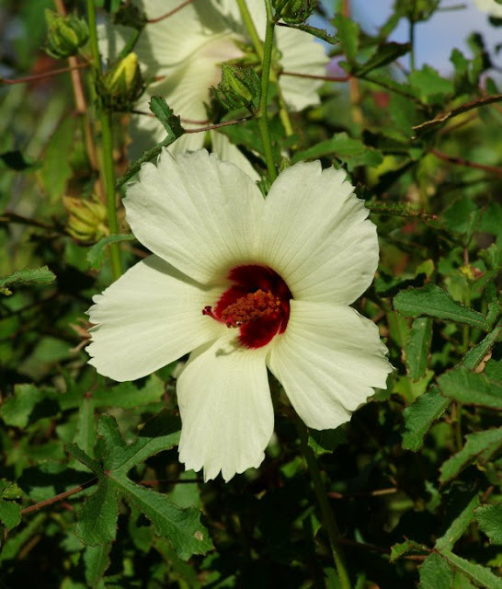
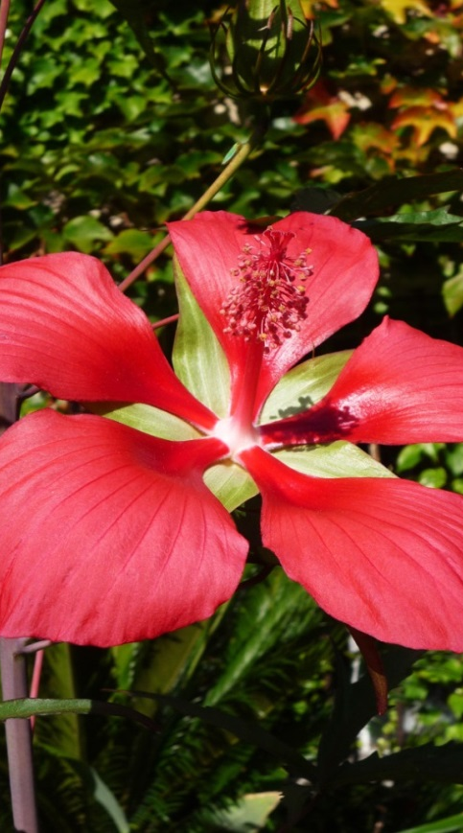
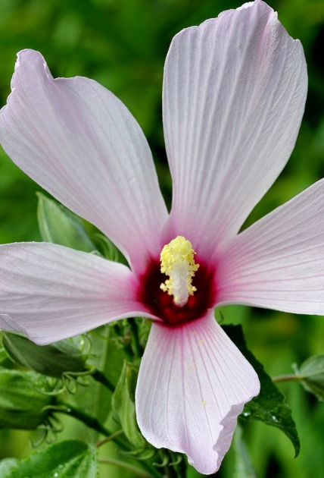
Native Hibiscus species

Slide 2
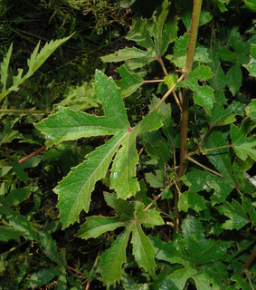
Comfortroot
Hibiscus aculeatus
Height – 3-6 feet
Flowering – Cream with red center – April - Nov
Habitat – wet pinelands, roadsides
Wildlife – attractive to bees & hummingbirds
Care – cut back to ground in winter, moist soil or sandy soil with irrigation, lives for 6 yrs

Slide 3
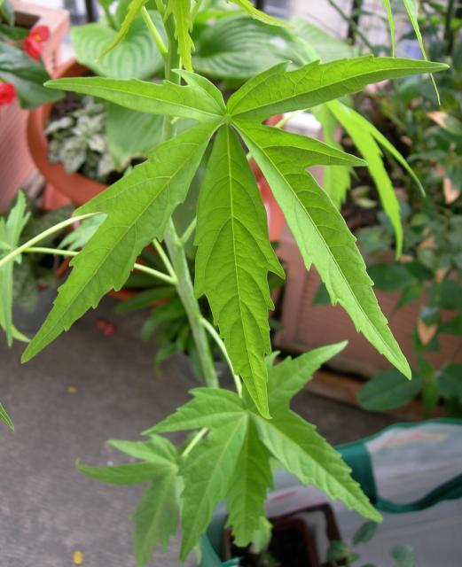
Scarlet Rose Mallow
Hibiscus coccineus
Height – 3-6 feet
Flowering – Deep red - July – Sept
Habitat – Freshwater marshes, streambanks, ditches
Wildlife – Butterflies & hummingbirds
Care – can get leggy in too much shade, average, moist to wet soils. Cut back in winter.

Slide 4
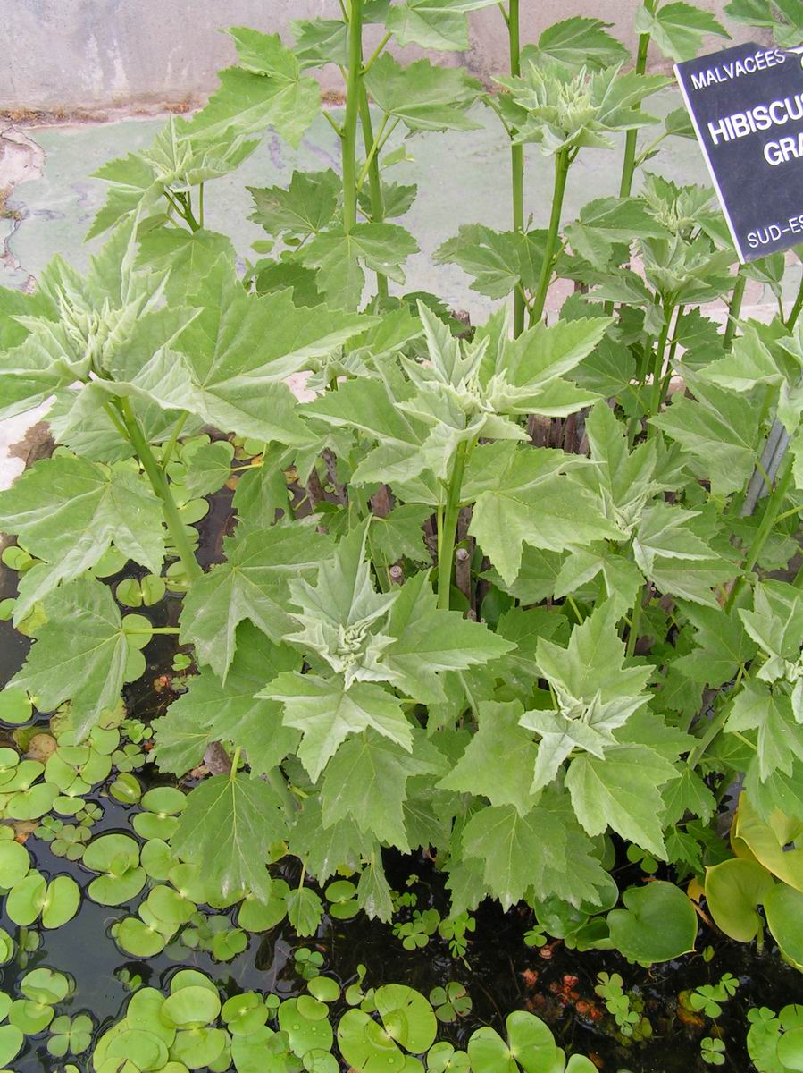
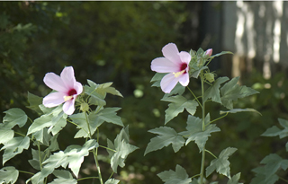
Giant Rose Mallow
Hibiscus grandiflorus
Height – 3-6 feet
Flowering – Dark Pink - March – Aug
Habitat – Freshwater marshes, streambanks, ditches
Wildlife –Bees, Butterflies & hummingbirds
Care – moist to wet soils. Cut back in late winter

Slide 5
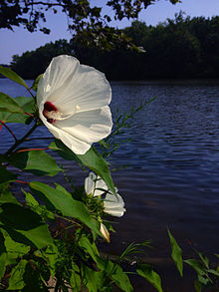
Swamp Rose Mallow
Hibiscus moscheutos
Height – 3-8 feet
Flowering – white to deep rose - July – Sept
Habitat – wetland edges, ditches, marsh edge
Wildlife – Hummingbirds
Care – can get leggy in too much shade, moist to wet soils. Cut back in winter.
/

Slide 6
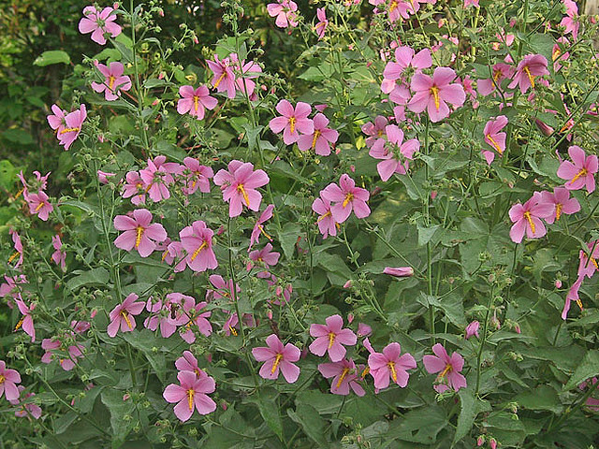
Seashore Mallow
Kosteletskya virginica
Height – 3-5 feet
Flowering – 2” Pink - June – Oct.
Habitat – Brackish marshes, wetland edges
Wildlife – Butterflies & hummingbirds
Care – prune spring for bushier plant, moist to wet soils. 5 yr lifespan
/

Slide 7
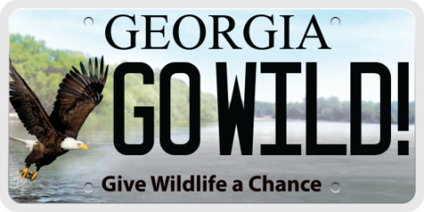
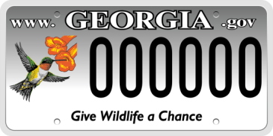
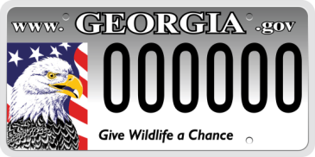
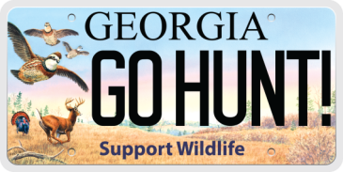
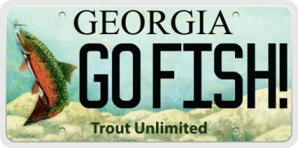
Wildlife License Plates
Upgrade for only $25 and show your support!
$19 of each tag purchase and $20 of every renewal goes to conserving Georgia wildlife.
Notes:
Upgrade to a new wildlife plate for $25 and show your support for Georgia wildlife!
The cost of buying or renewing a wildlife plate is only $25 more than a standard “peach” license plate.
$19 of each purchase and $20 of each renewal goes directly to the Wildlife Resources Division programs that depend on the plates.
Check out these wild tags at your county tag office and make a bold statement for wildlife conservation by outfitting your vehicle with one of these eye-catching designs.
Funds from tag purchases and renewals are the largest source of contributions to Georgia’s Wildlife Conservation Fund and the Bobwhite Quail Initiative, programs that depend on these donations!
Tags are the #1 source of funds for nongame conservation in Georgia

Slide 8
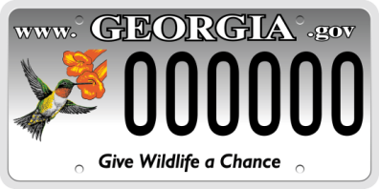
Show Your Support
At Your County Tag Office:
Ask for a wildlife plate
Pay the fee. Wildlife plates cost only $25 more than a standard peach plate. The total cost is $25 for the plate, plus the standard $20 registration fee you will pay for any tag and any applicable ad-valorem taxes.
Receive a temporary tag from the county
Watch the mail for your wildlife tag. It can arrive as soon as within a week!
When buying a car:
Many Georgia car dealers offer the option to purchase a tag when you buy a vehicle. Simply ask them to upgrade you to a wildlife tag when you're asked what kind of tag you want!
Renewing Your Wildlife Tag
You can renew at your county tag office or -- in most counties -- online.
Renewing a wildlife tag costs only $25 a year, plus the standard $20 registration fee and applicable ad-valorem taxes.
Notes:
Purchasing a bald eagle or a ruby-throated hummingbird plate supports the Georgia’s Wildlife Conservation Fund. Established by state law, this fund benefits endangered and nongame wildlife and plants through conservation, education, land acquisition and recreation projects. Renewing these and the older eagle plates also supports this work.
Georgia’s bobwhite quail, white-tailed deer and wild turkey plate, as well as the older quail-and-deer plate, contributes directly to the Bobwhite Quail Initiative, which has created critical habitat for quail nesting, feeding and cover. This program has positively affected more than 20,000 acres for quail, songbirds and other native animals and plants that depend on this habitat.
Each purchase or renewal of a Trout Unlimited license plate supports Georgia’s trout conservation and management programs. These efforts affect trout production, stocking and stream restoration throughout North Georgia.

Slide 9
Questions?

